Slide 1

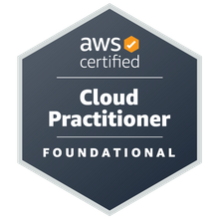
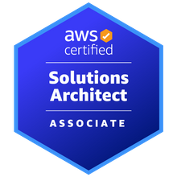
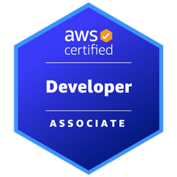
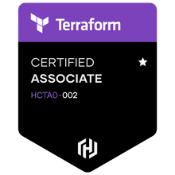
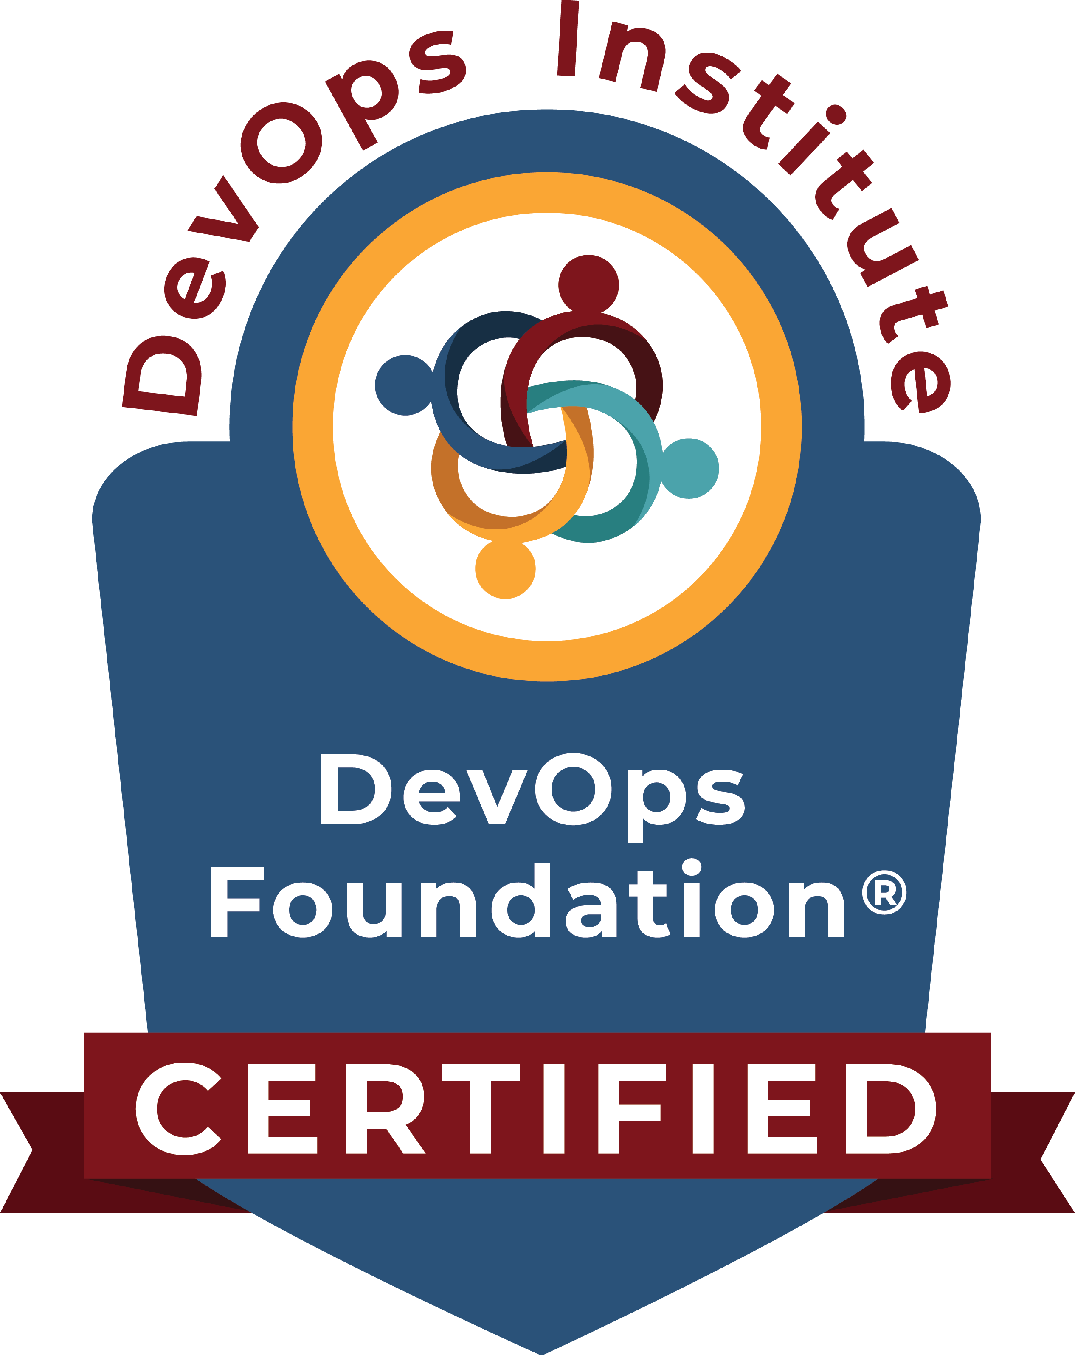

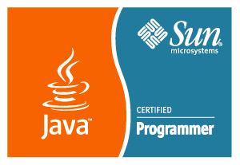
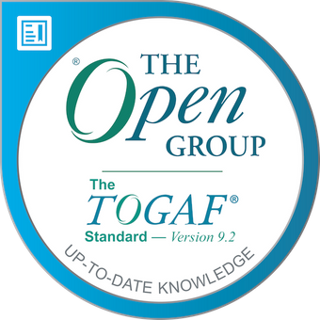
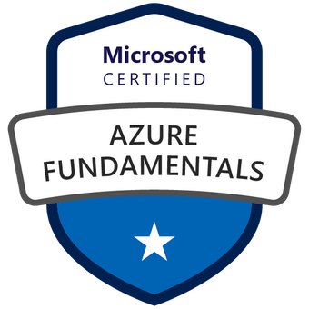
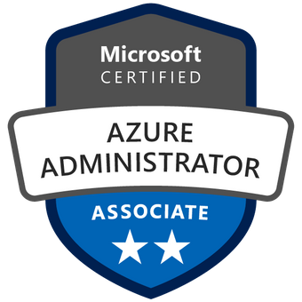
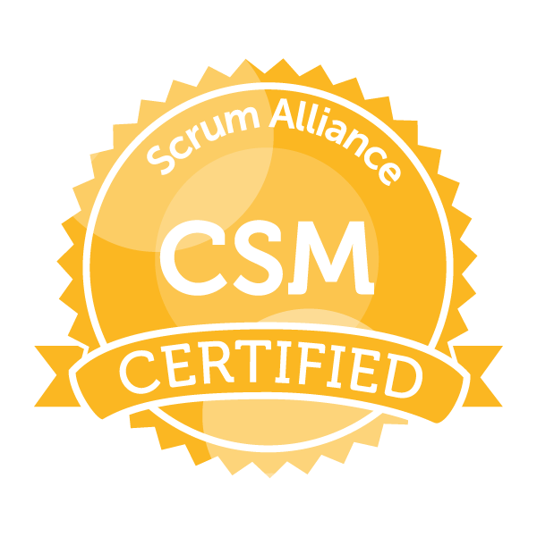
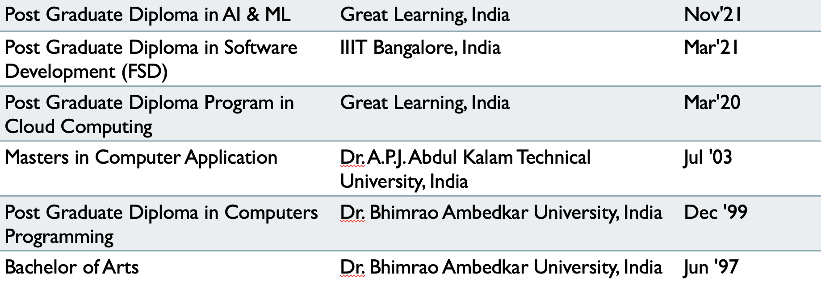
Mayank Chugh
LinkedIn: www.linkedin.com/in/mchugh44
Git: https://github.com/mayankchugh1977
Senior Manager - Cloud Architect
Summary
Relevant Experience
Hands-on solution-driven IT professional with 20+ years of extensive experience as a consultant, solution architect, Security Designs, project manager, team lead, and senior engineer for multiple software development projects. Focus on pre-sales, product scoping & pricing, solution development, project management, release management, network engineering, and systems administration. Energetic and recognized for having excellent communication and problem-solving skills spanning multiple technical towers and global enterprises.
Client: HSBC
I worked on Robo Digital Advisory for iOS and Android mobile app development as Solution Architecture (API and Cloud) to gather and design project requirements by having multiple interactions, meetings, and walkthroughs with business leaders, users and architects to document Architect design, flowcharts, sequence diagrams as Software Design Document in Confluence.
I successfully delivered Complete Cloud Applications Quantum API integration layer architecture for a new initiative for a global money project.
Participated in Multiple Pre-sales assignments for providing Cloud Migration approach as SME for High availability, Fault-tolerant and resilience application to the client.
As SME Looking after Lift and Shift Monolithic application migration of Java + Oracle RDS application to AWS. Also, Mentoring team in the right direction daily during scrum calls or separate sessions.
Client: CHANEL
Participated in Pre-sales activity for providing High availability, Fault tolerant and resilience application to the client.
Working closely with delivery head, fellow Architects and other members for delivering complete IT solutions. Contributing as SME for application implementation and Azure cloud for accepted SLA, RPO and RTO.
Client: Cathay Pacific Cargo Terminal & Asia Airfreight Terminal
Gathered project requirements (150+ of AAT and 35+ of CPSL) through interactions, meetings, and walkthroughs with potential application users and develop business requirements documents (BRD), functional requirements documents (FRD), and user mock-ups. Also, I created 55+ technical responses to Requests for Quotes (RFQs) for customers.
I Provided winning solutions as part of the pre-sales team, which included responding to RFPs and RFIs from existing and prospective clients. Recently, involved in a proposal for the migration of Monolithic to cloud study. Conducted a few POCs for the same Participated in both pre-sales and post-sales activities, including establishing statements of work, responsibility matrixes, and overseeing the technical realization of solutions by delivery teams.
Worked closely with executive sales teams to deliver quotes and full IT solutions in networking, computing, storage, and virtual cloud infrastructure. Also, Designed and developed projects: On-premise Storage move to AWS, OCR using AI Computer vision, AWS IOT using MQTT (pub/sub) for controlling Cold Box for warehouse cargo application.
Monitor SLA and tested application performance to identify potential bottlenecks, develop solutions, and collaborate with developers on solution implementation for 5 Web, 3 Mobile applications. Provided 2nd and 3rd level technical support and troubleshooting to internal and external clients. Team Size - 4 - on-site resources, 4 - offshore resources.
Successfully managed multimillion-dollar revenue accounts including focus on several Completed 15.5K days of works. I have managing releases during all phases of software development life cycle, from requirements analysis through system implementation for more than 2 enterprises projects. Worked closely with customers, internal staff and other stakeholders to determine planning, implementation and integration of system-oriented projects. System development of RESTful API for having interface with HKIA.
Skills
Project lifecycle management; Project manager supervision; Architecture Change Management; Migration Planning; Release management; Technical project planning; Project requirements analysis; Build technical teams; Technical documentation understanding; Solution Technical architecture (Application + Cloud); Security Designs/Patterns; Project scheduling and budgeting; Custom software development and database design; System migration/integration; Quality assurance
Cloud Services: AWS; DevOps: GIT, Jenkins pipeline, AWS CI/CD pipeline, Ansible, Containers, K8S, Terraform; Languages: Java / J2EE, EJB, Spring Boot, JavaScript, Struts 1.x MVC, Python; Databases: Oracle, MySql; Reporting tools: iReport, Jasper Report; Version Control: GIT, SVN, VSS; Web Services: SOAP, Rest API Development; Management Tool: JIRA, Confluence; Maximo, Bugzilla; Machine Learning: Supervised Learning – Linear/Logistic Regression, Decision Tree, Random Forrest Tree; Operating Systems: Windows (XP, 10), Lunix and Ubuntu; Methodologies: Agile, Waterfall Model
Education

Slide 2

Version Control with Git
What is Version Control System
Version control systems are a category of software tools that help a software team manage changes to source code over time. Version control software keeps track of every modification to the code in a special kind of database. If a mistake is made, developers can turn back the clock and compare earlier versions of the code to help fix the mistake while minimizing disruption to all team members.

Slide 3
Centralized version control systems are based on the idea that there is a single “central” copy of your project somewhere.
Committing” a change simply means recording the change in the central system.
Other programmers can then see this change. They can also pull down the change, and the version control tool will automatically update the contents of any files that were changed.
Centralized Control System

Slide 4
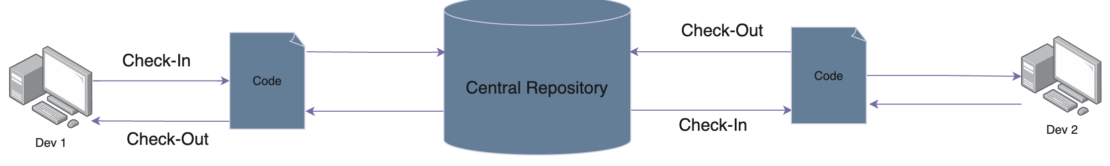
Client - Server Repository Model

Slide 5
Centralized Version Control Workflow
Pull down any changes other people have made from the central server.
Make your changes, and make sure they work properly.
Commit your changes to the central server, so other programmers can see them.
Some of the most common centralized version control systems you may have heard of or used are CVS, Subversion (or SVN) and Perforce.

Slide 6
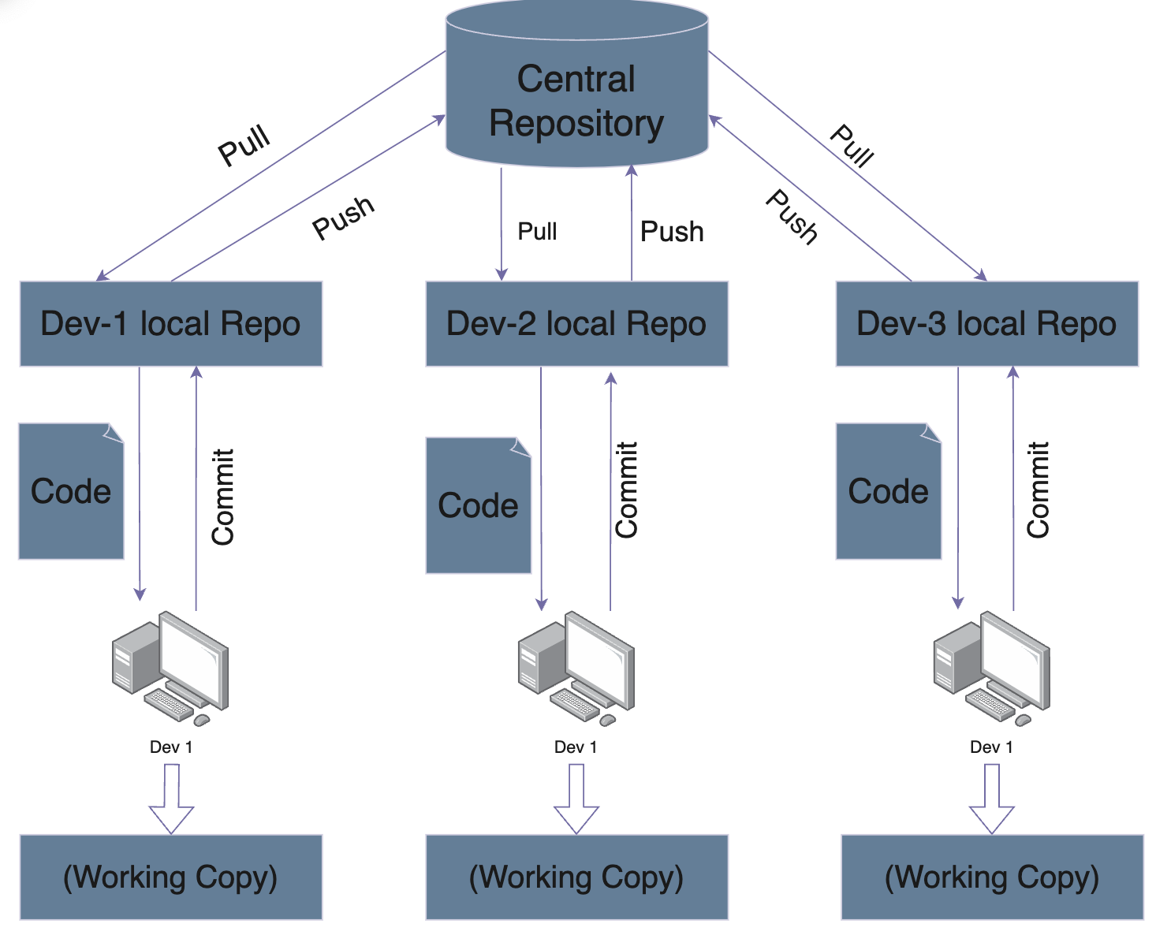
Distributed Version Control Systems (DVCS)

Slide 7
Advantages
Performing actions other than pushing and pulling changesets is extremely fast because the tool only needs to access the hard drive, not a remote server.
Committing new changesets can be done locally without anyone else seeing them. Once you have a group of changesets ready, you can push all of them at once.
Everything but pushing and pulling can be done without an internet connection. So you can work on a plane and won’t be forced to commit several bug fixes as one big changeset.
Since each programmer has a full copy of the project repository, they can share changes with one or two others at a time if they want to get feedback before showing the changes to everyone.

Slide 8
What is Git
Git is the most commonly used version control system today, quickly becoming the standard for version control.
Git is a free and open-source version control system created by Linus Torvalds in 2005.
Git is distributed version Control System means your local copy of code is a complete version control repository.
You commit your work locally and then sync your copy of the repository with the copy on the server.
Git is a DevOps tool used for source code management. It is a free and open-source version control system used to handle small to very large projects efficiently. Git is used to tracking changes in the source code, enabling multiple developers to work together on non-linear development.

Slide 9
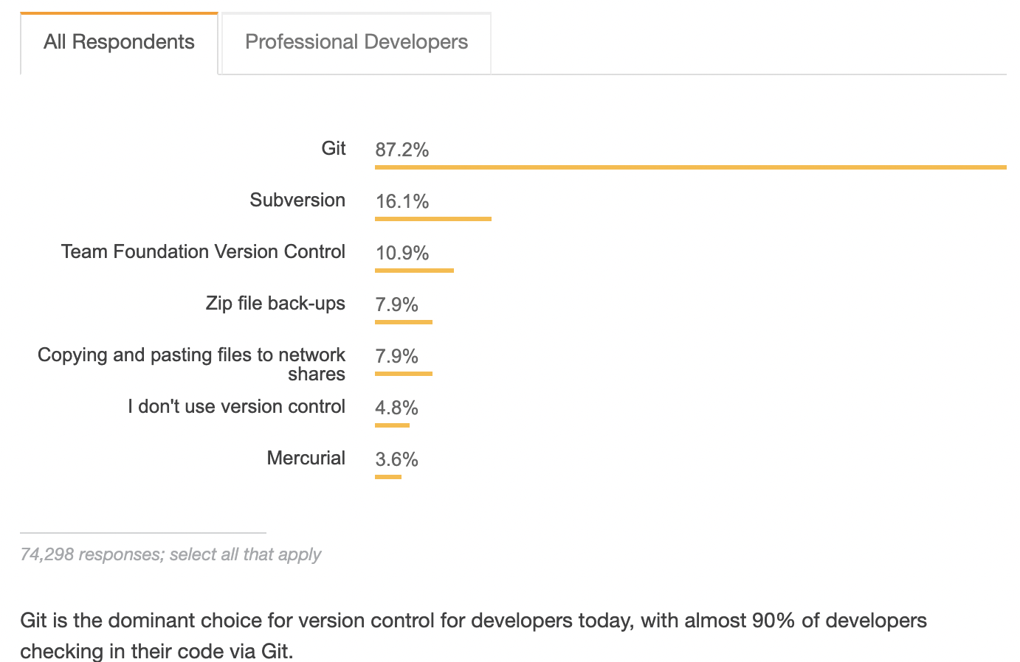
Standard Version Control System
https://insights.stackoverflow.com/survey/2018#tech-sourcecontrol

Slide 10
GIT
Git is a version control system used for tracking changes in computer files. It is generally used for source code management in software development.
Git is used to tracking changes in the source code
The distributed version control tool is used for source code management
It allows multiple developers to work together
It supports non-linear development through its thousands of parallel branches
Features of Git
Tracks history
Free and open source
Supports non-linear development
Creates backups
Scalable
Supports collaboration
Branching is easier
Distributed development

Slide 11
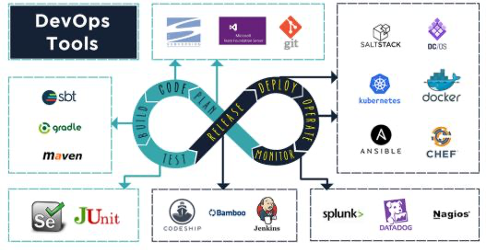

Slide 12
Git installation
Below command is used to update the yum repository so that git package should be available.
sudo yum –y update
Command to install git (it will ask to install the package then press Y )
sudo yum install git

Slide 13
Git Daily Commands
Create Repositories
git init
Make Changes
git add git commit git status
Parallel Development
git branch git merge git rebase
Sync Repositories
git push
git pull git add origin

Slide 14
Git Advance Commands
git stash - which makes a temporary, local save of your code
git reset - which lets you tidy up your code before doing a commit
git bisect - a function that allows you to hunt out bad commits
git squash - which allows you to combine your commits
git rebase - which allows for applying changes from one branch onto another
https://www.toptal.com/git/the-advanced-git-guide
https://blog.openreplay.com/top-dozen-advanced-git-commands-to-know/

Slide 15
Projects & POCs
WebLogic to Jboss and Oracle to MySQL Migration – Monolithic Application Migration to AWS Cloud
On Premises Application Migration to AWS - POC
As part requirement client want to migrate application. We would need prepare quicker roadmap to best optimal ways for migration for Monolithic application to AWS Cloud with all possible options. As a vendor, we have migrated basic framework and one of module of existing from Weblogic application Server to Jboss Server. Also, We have done all required changes for migrating Oracle database to Mysql/Aurora database.
Skills and Tools – RedHat Jboss migration tool, Jboss The AWS Schema Conversion Tool (AWS SCT)
Mobile Apps Development for Cargo Users – Development and Magnificence for iOS and Android Application
Hybrid Cloud Management – combination of Public and Private cloud
Provide cost optimization solution, Business, information and technology architecture and maintenance support to client for their new Mobile apps and upgrades Mobile Apps. To handle complex business functionality of Transhipment and intermodal functionalities. Application should allowed the agents, truck drivers and carrier airlines to view schedule and status of flights so that the shipment can be planned for delivery and pick-up. This app enabled user to track the status of Export/Import/Transhipment shipments. It also provid notifications to the user when the Import shipment is ready for pickup so that user can plan and schedule the travel to Cargo Terminal to pick-up the same. It reduced the customer support effort of Cargo Terminal Operator by self-servicing of flight schedule/AWB Enquiry and Notification. It also allowed users to choose languages of choice.
Skills and Tools – J2EE, Oracle, App Notification and Google Notification

Slide 16
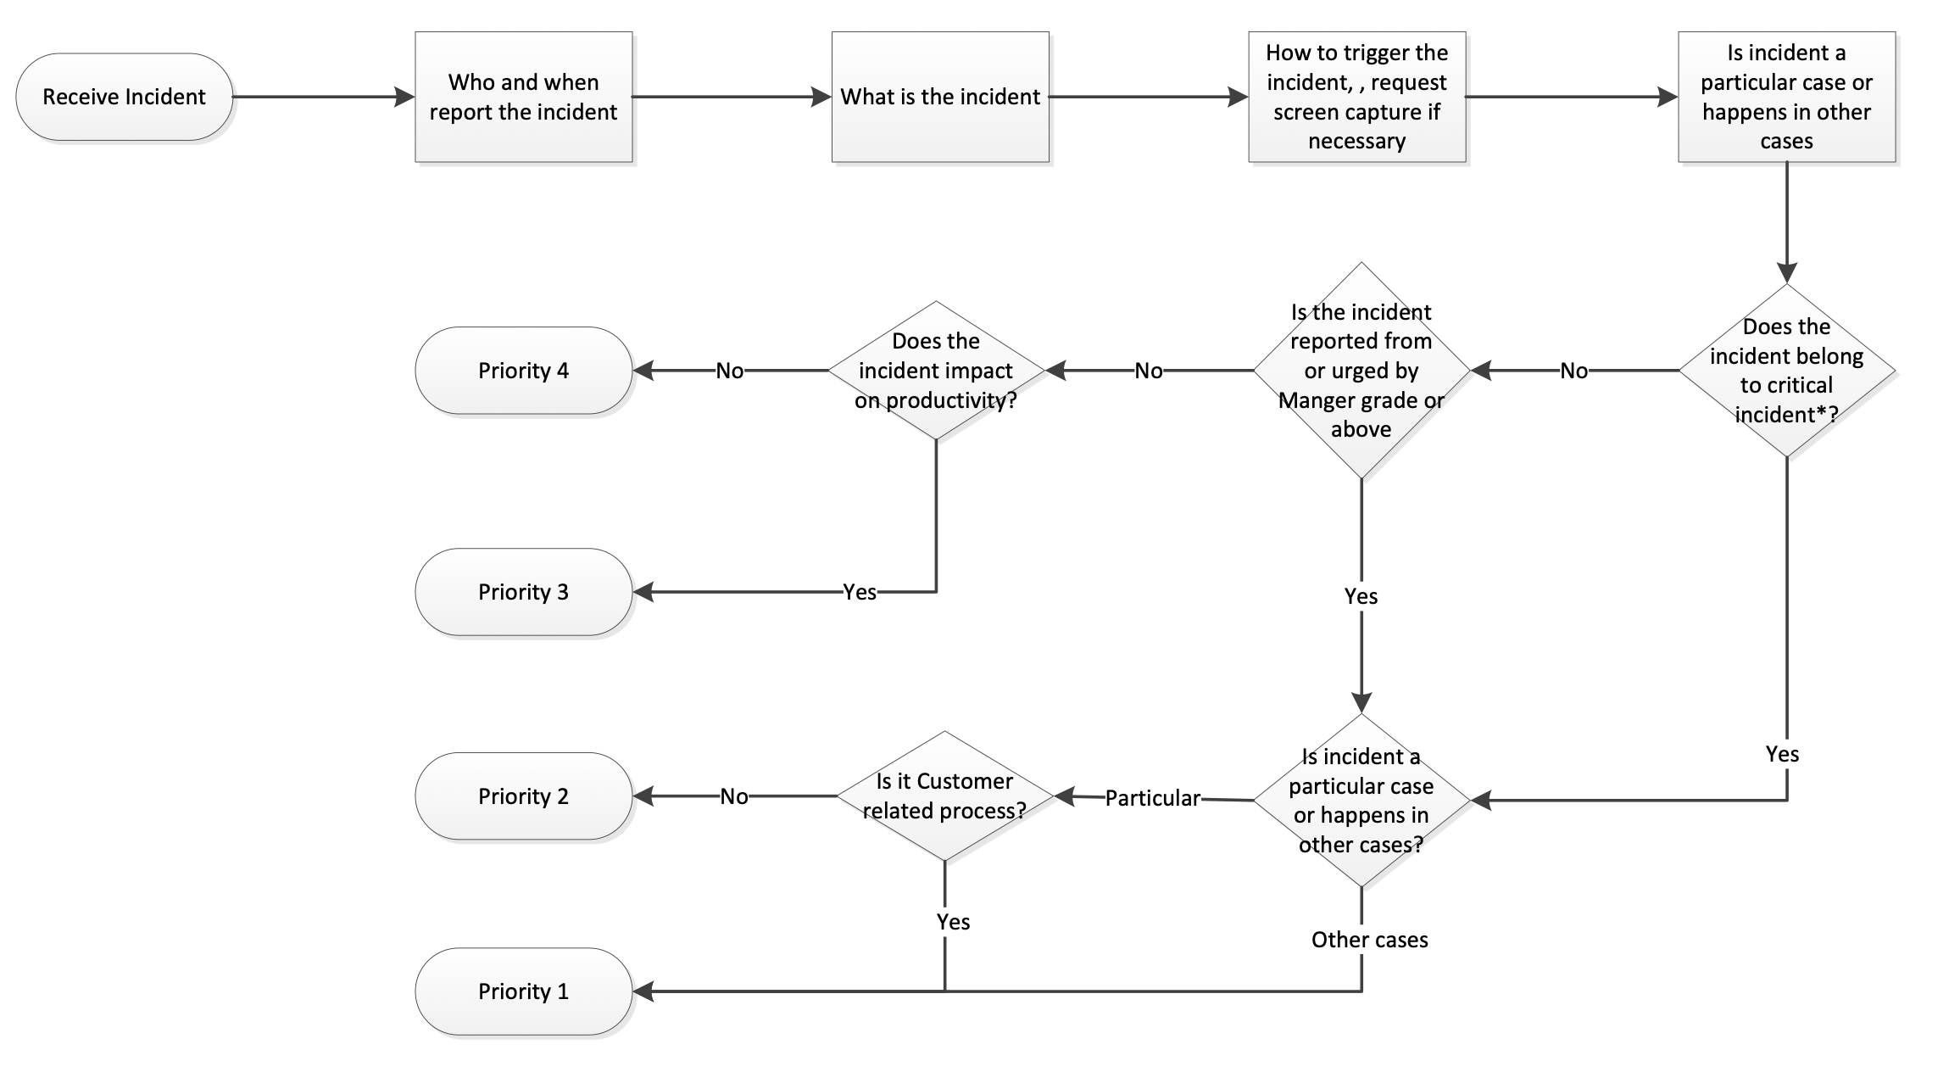
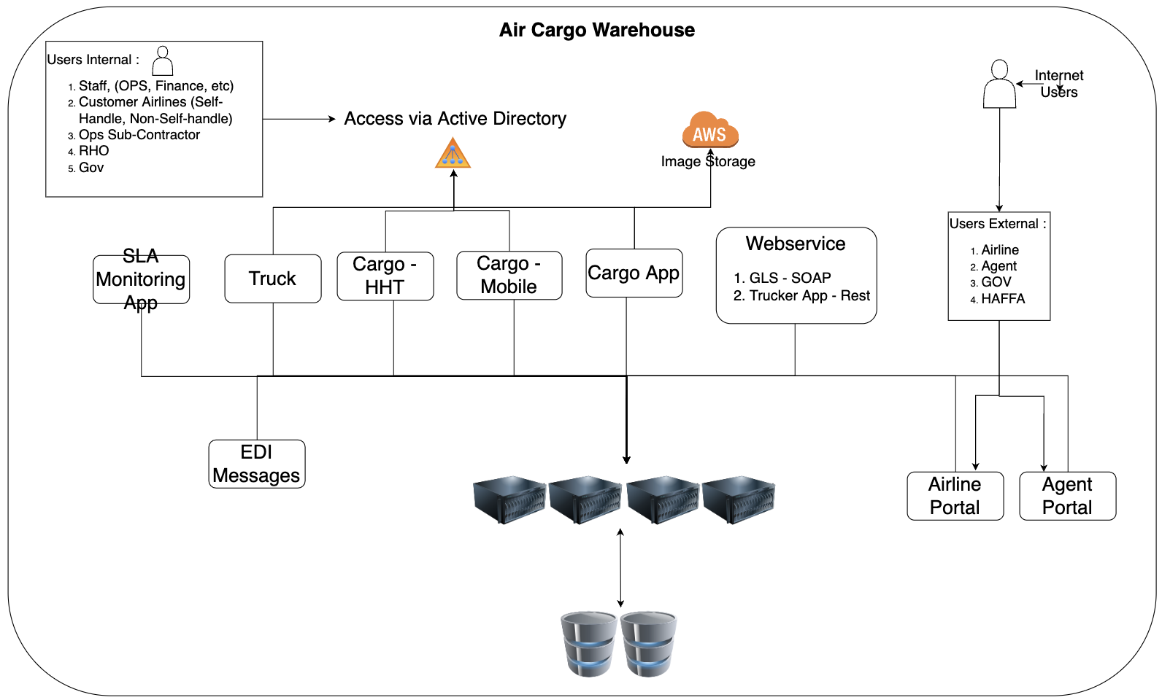
Cargo Application – Support and Maintenance
Incident Management Process (SLA Adherence)
High Level Architecture

Slide 17
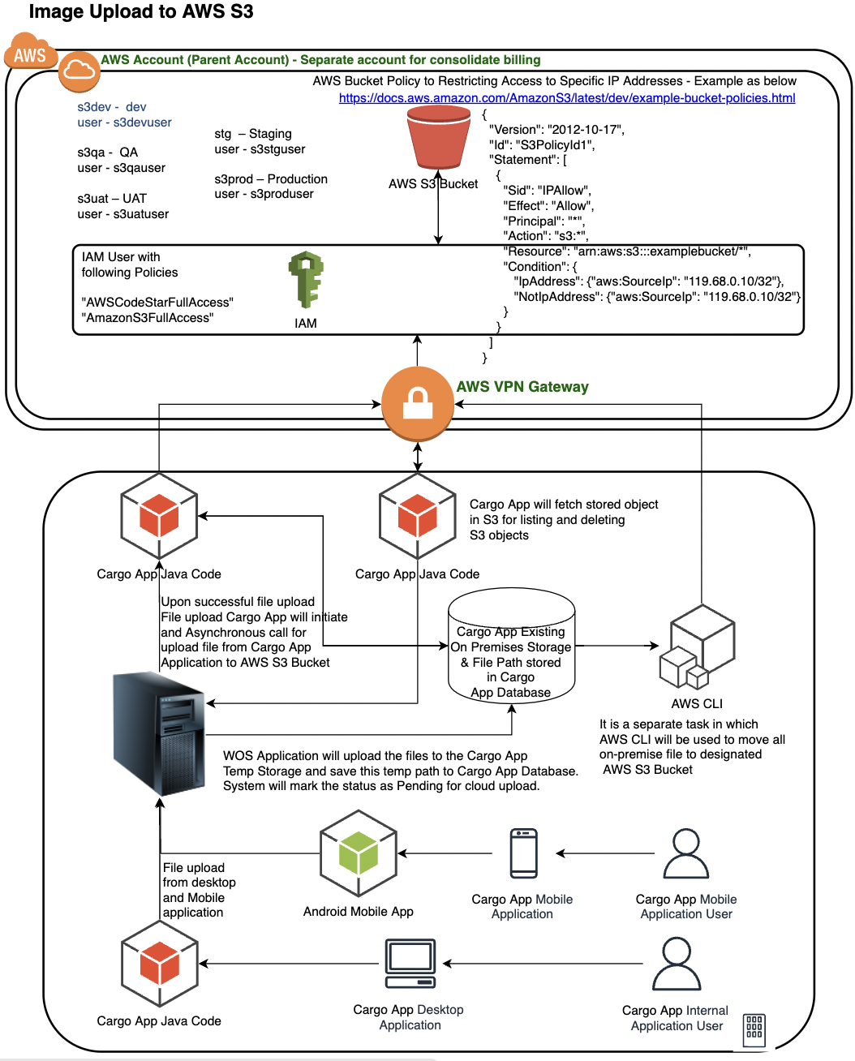
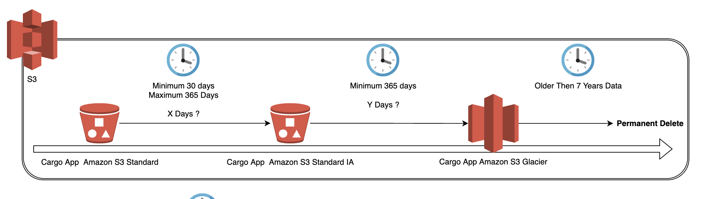
Storage Migration from – Om Prem to Cloud Storage
Image Upload to Cloud
Archival Lifecycle on Cloud
Storage S3, CLI - Cloud Computing on AWS
On Premises File Storage to AWS S3:
Provides fault tolerant, highly available design → development → deployment → monitoring → maintenance → data analytics support for file upload Migration from on-prem files storage to AWS S3 bucket logic. In-addition, This enhancement provides the capability to upload the image, document, video and store the files in AWS S3 Bucket instead of on prem storage.
Skills and Tools - S3, AWS SDK (Java), awscli

Slide 18
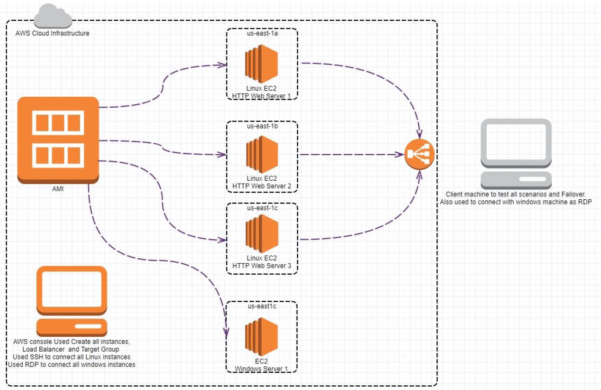
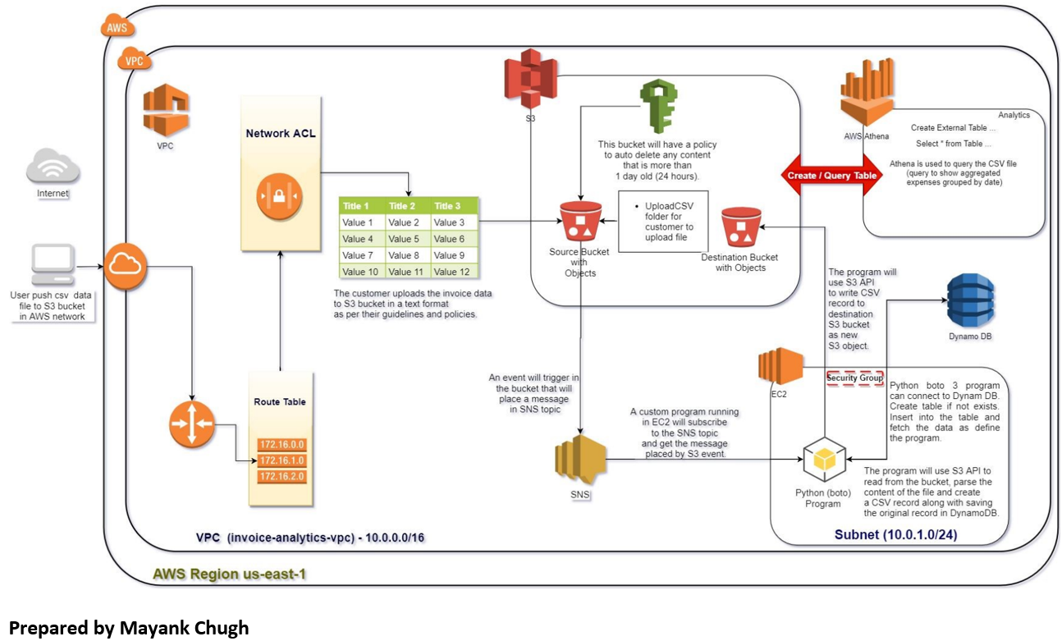
Cloud POCs
EC2 | Multi AZ Deployment | Load Balancing Deploy multiple EC2 instances in different AZs and experiment with load balancing, target groups and understand the impact of instance failure | Creating a file share & sync solution using ownCloud and AWS: Scenario -Solving the Dropbox Problem; These files, containing sensitive company and customer data, are stored in a public cloud outside of the businesses' control -possibly even outside of the country. The potential for data leakage and security breaches is enormous and companies need to stay compliant with their own policies and procedures for security and governance Skills and Tools - Amazon EC2, Load Balancer | Building an Automated Business Process using Managed Services on a Public Cloud In the connected world, it is imperative that the organizations be interlinked with the customers and vendors. This process has been very sluggish, manual, batch-based and prone to failures. Such Integration design has lead to impaired decision making and delays in the detection of fraudulent actions. This project created an automated, event-based real-time process using managed cloud services that do not have these limitations. Services & Concepts - VPC, IAM, EC2, Athena, SQL, Programming etc. Skills and Tools - Athena, Dynamo DB, S3, SNS

Slide 19
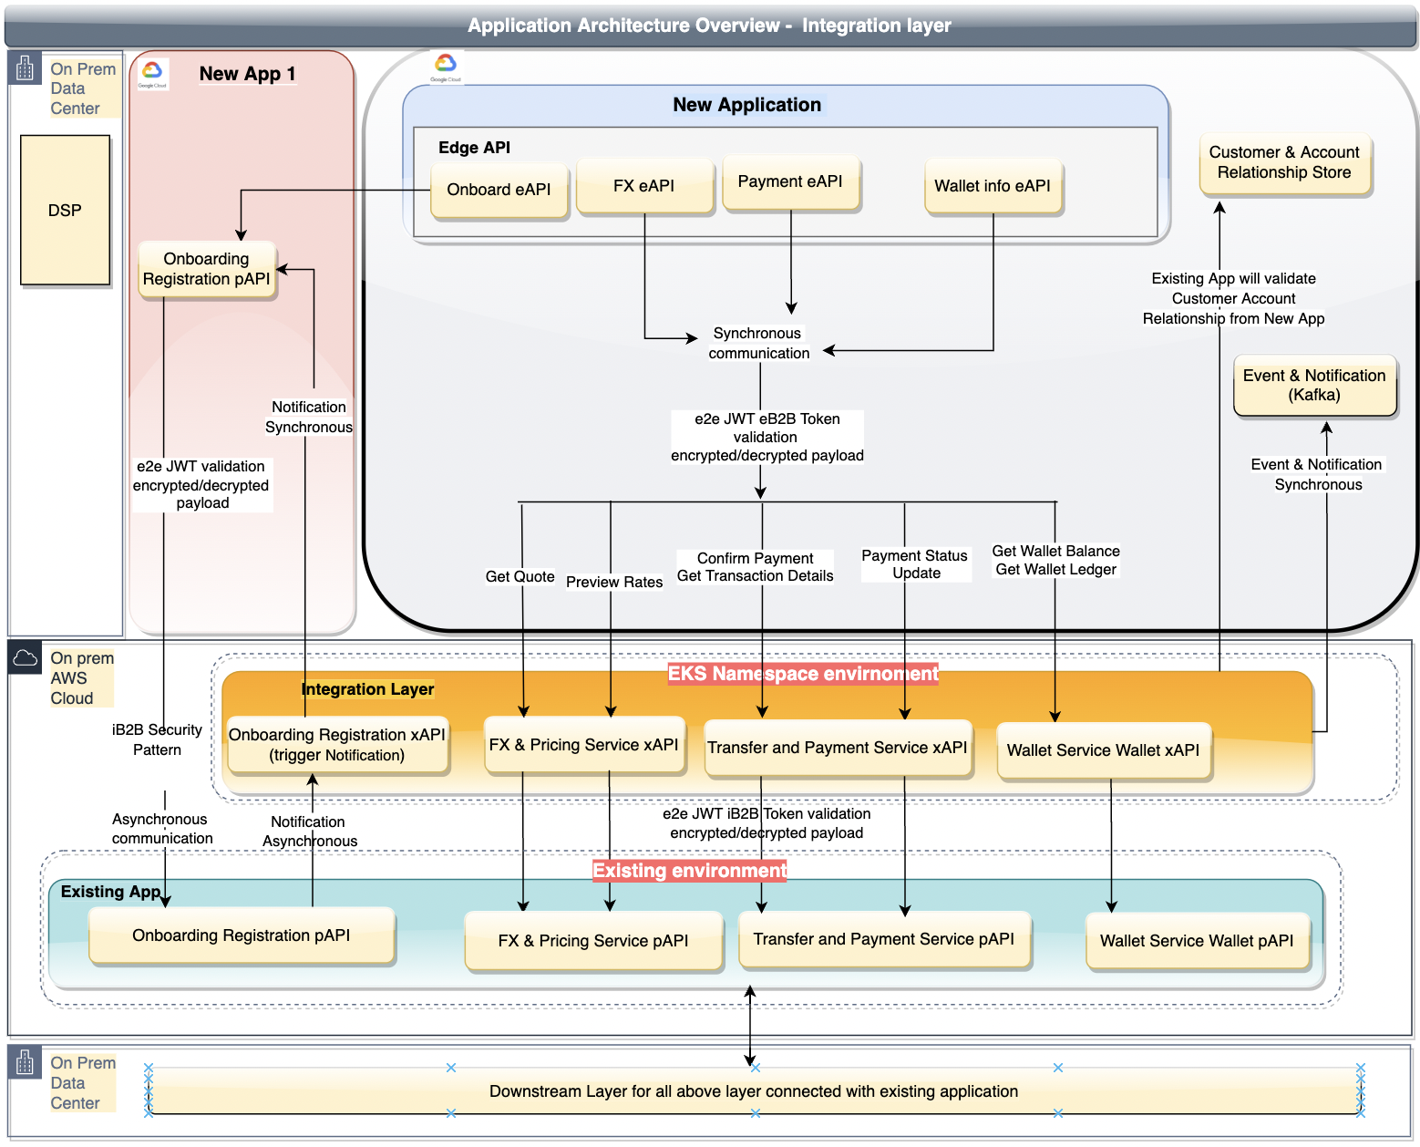
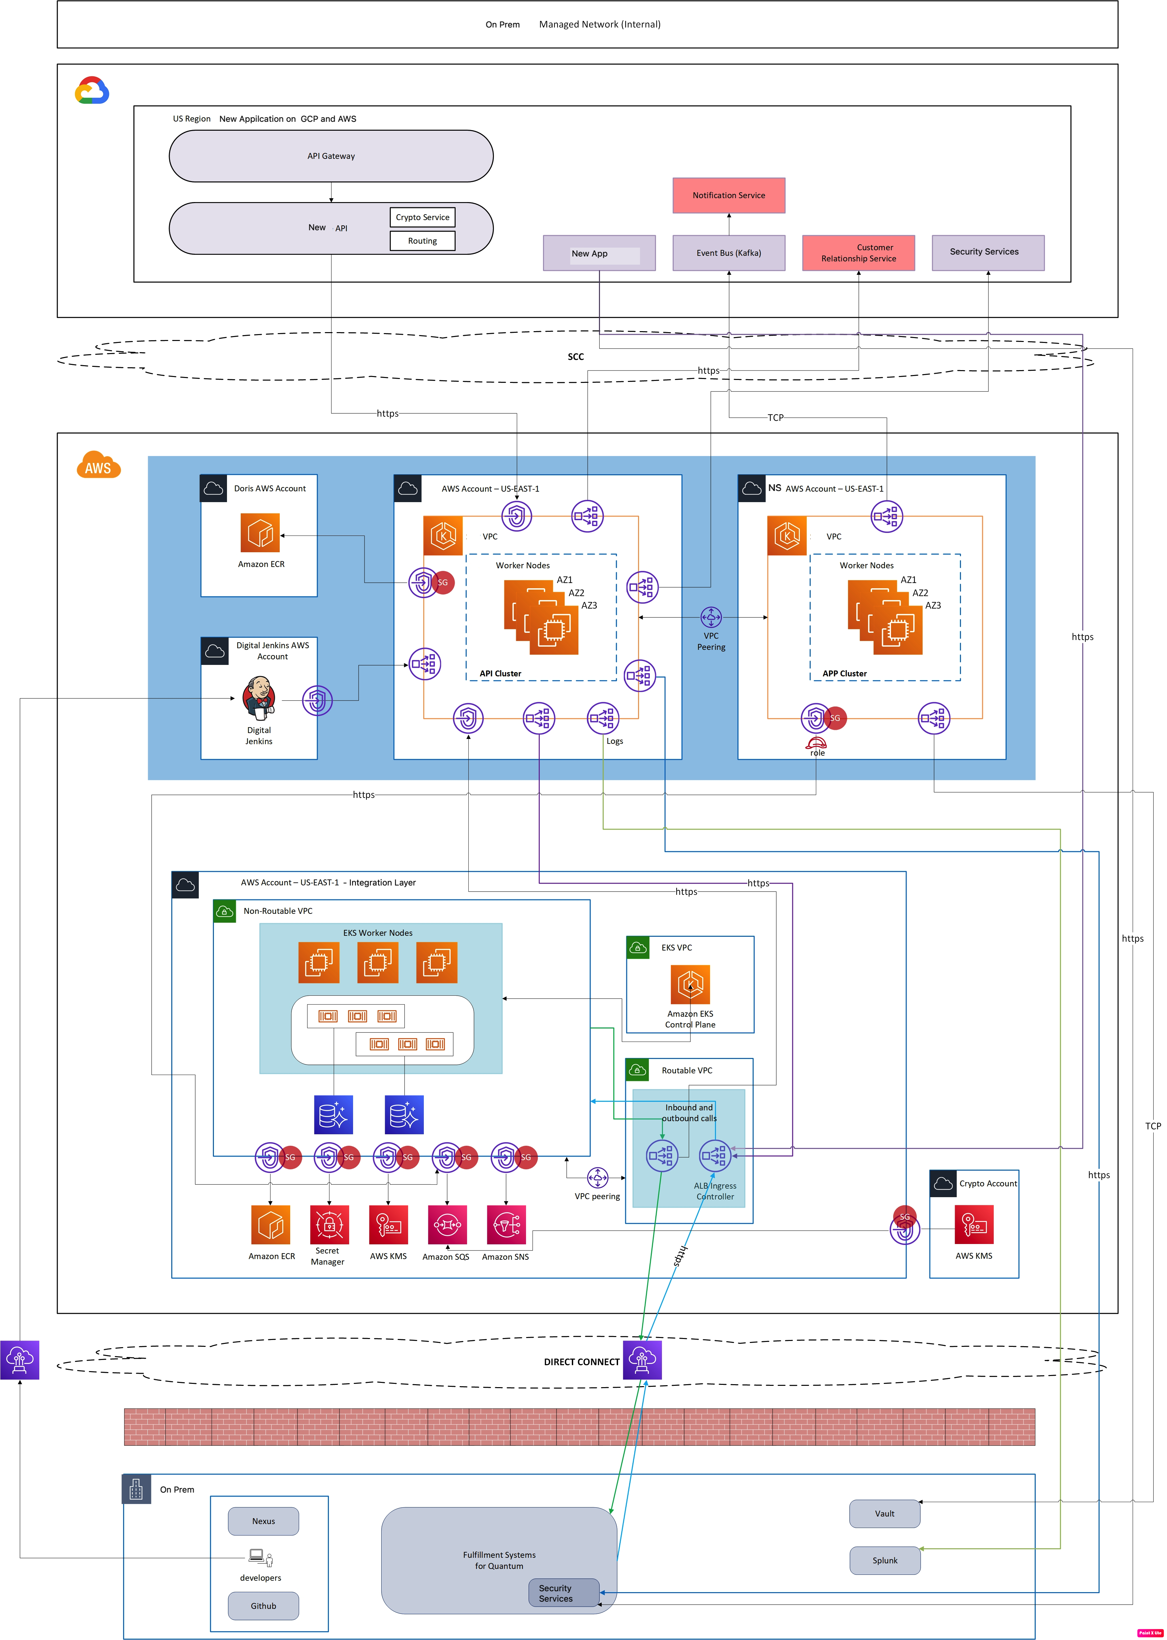
Integration Layer
Application Architecture Design
Infrastructure Architecture Design
API Integration layer
This is an enhancement to New Application, the Old platform. Partners users will onboard by using New application system & system will use the digital wallet service provided by Old Application. So we have introducing new Integration Layer introduces a thin API layer on top of existing Old Application services which would validate the API requests from new application & execute underlying Old application services. AWS EKS Namespace (useast-1) platform would be use for deployment and host APIs.

